Slide 1
Review – I by
Group no:- 3

Slide 2
Introduction
Predicting students performance accurately is very challenging and important in terms of their further Education and to find their area of interests that will help them improve their weak sections. The main objective is to provide an implementation of Novel Machine Learning Techniques to predict students Performance.
The challenges faced by existing systems are for the accurate prediction the dependency between subjects must be identified, students evolving progress needs to be incorporated into the prediction.

Slide 3
Literature Survey
In Indian education system checking student’s performance is a very essential in higher education.
Some institutions student performance can be observed by using internal assessment and co-curriculum.
There are lots of definitions of student academic performance prediction should be given in the literature. Different authors are using different student factors/attributes for analyzing student performance.
Most of the author used only Academic data to Analyze the results which are not only based on Academic Performance but individual behavior .
For better performance prediction it is important to consider students extra co-circular activities and their Method of studying.
Due to increase rate in drop Outs ,predicting student's academic performance motivated us to do further research work in our own educational environment.

Slide 4
Problem Statement
Student Performance Prediction based on academic performance history and analysing behavioural pattern to improve results.

Slide 5
UML DIAGRAMS

Slide 6
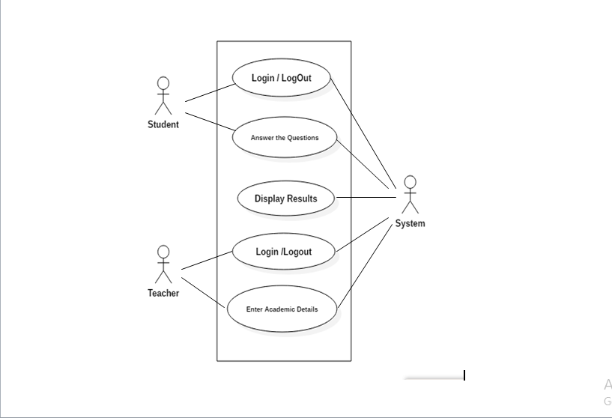
Use Case Diagram

Slide 7
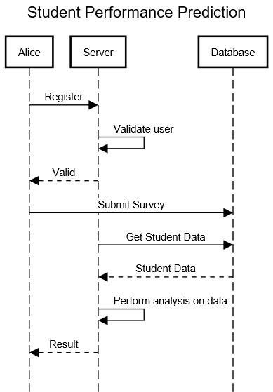
Sequence Diagram

Slide 8
Screen Shots

Slide 9


Slide 10
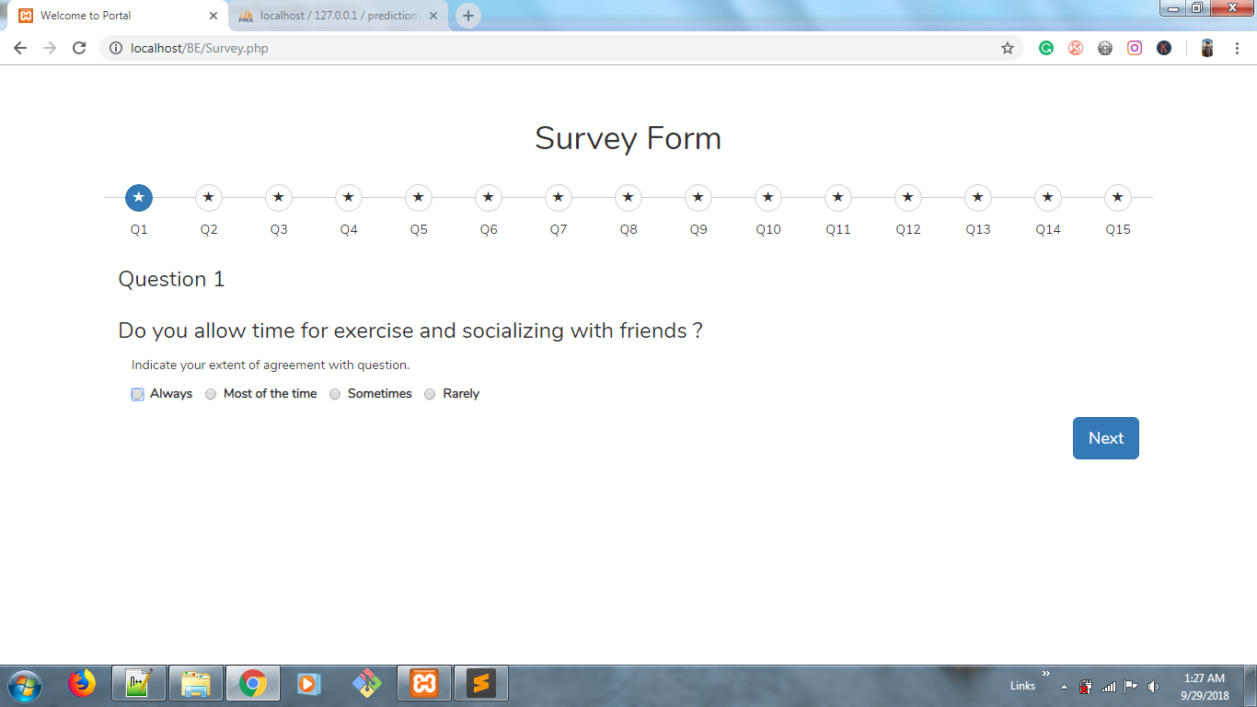

Slide 11
Thank You !

